Slide 1
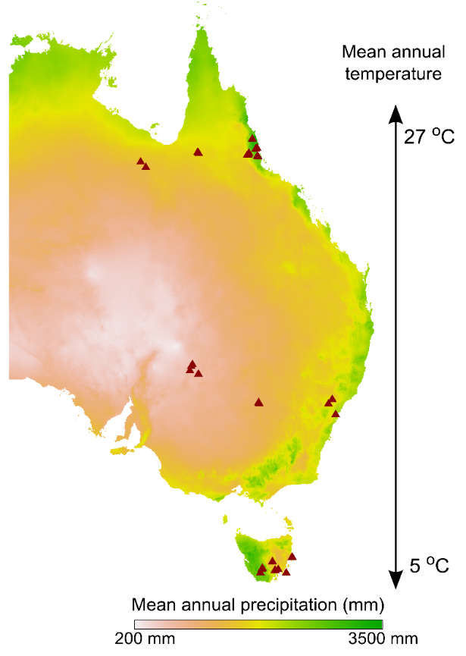
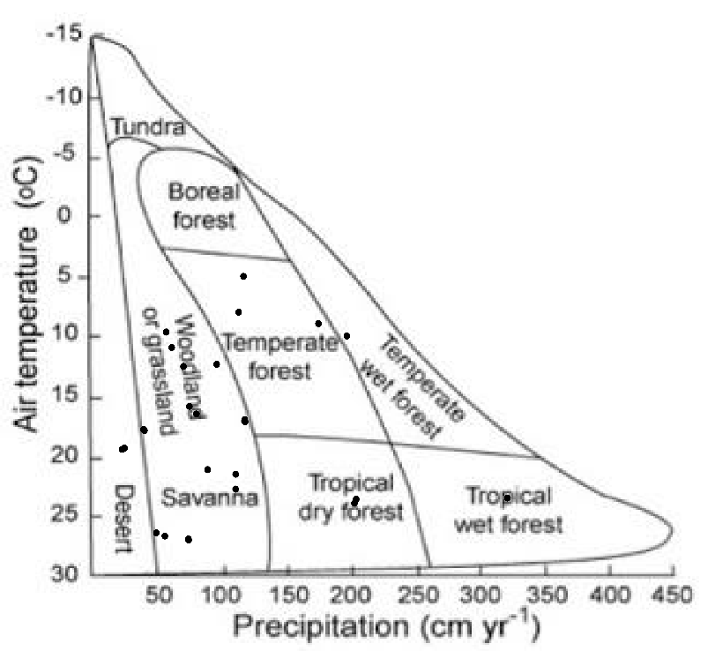
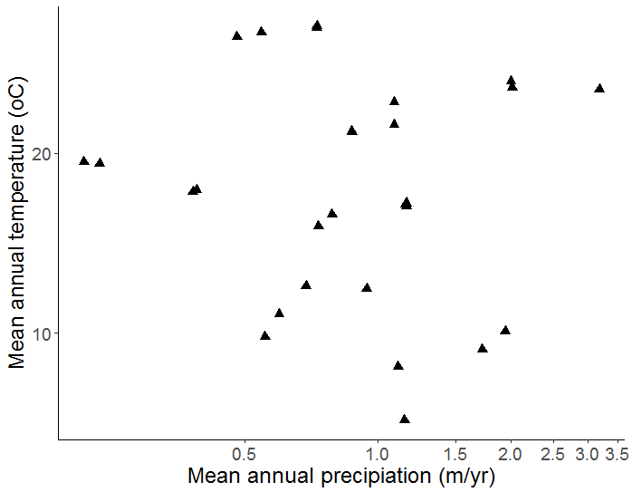
a
a
b
c
Notes:
1.) Quantifying leaf proteins at the continental scale. A total of 324 photosynthetically active Eucalypt leaf samples were collected from 32 species; four species were recorded at multiple location. For each species-location combination, three canopy leaves were collected from each of three individuals to make a total of nine samples.
a.) Sampling locations (triangles) were located along three latitudinal bands, spanning broad gradients of rainfall and temperature. The resulting coverage of climate space represents of much of the vegetated area of the Australian continent;
b.) Sampling locations lie within six of the eight biomes described by Whittaker (1967).
c.) Mean annual temperature (oC) and mean annual precipitation (mm, log scaled) of sampling sites (triangles) are distributed orthogonally with respect to one another (r = ).

Slide 2
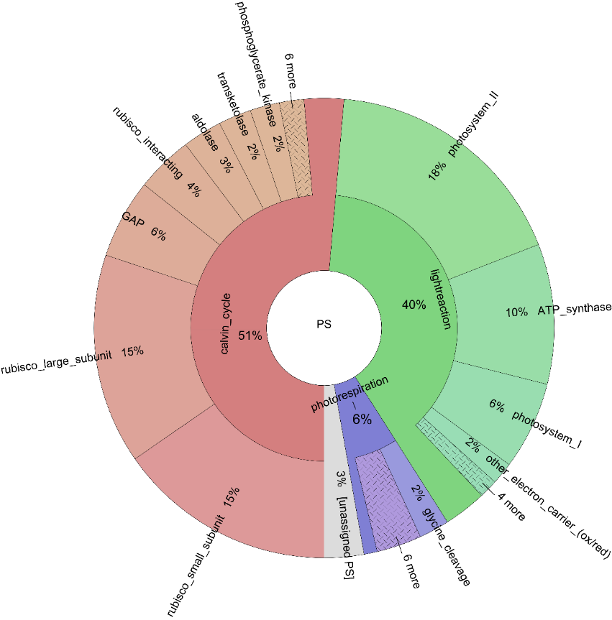
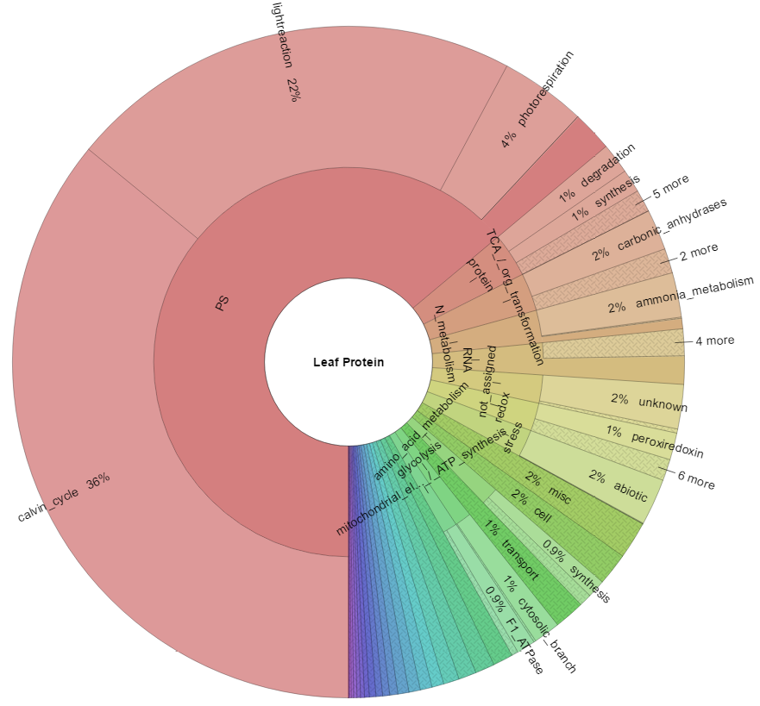
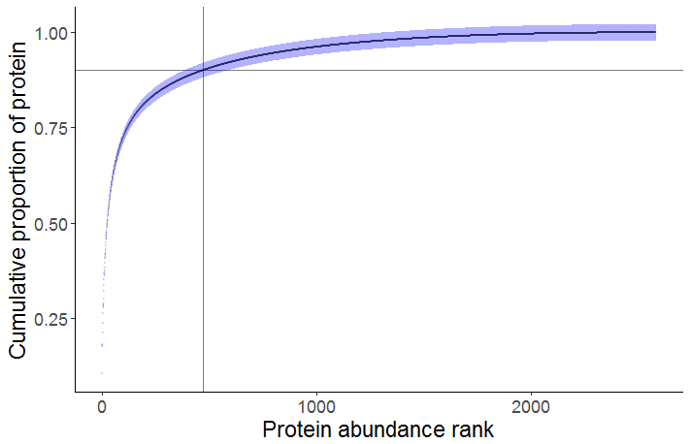
a
b
Photosynthesis
64%
c
d
<500 proteins account for >90% total leaf protein
Notes:
2.) Protein composition of the average eucalypt leaf.
a.) We used a hierarchical protein functional annotation system (MAPMAN/Mercator, ref) to assign proteins to functional groupings. Here we show average abundances of proteins associated with all major functional groupings in eucalypt leaves (left) and within photosynthesis (right); angular fraction indicates the proportion of protein associated with a named functional category. % values represent averages of leaf 324 samples across 32 eucalypt species. The hierarchical annotation scheme is represented by the layers of the plot: the innermost layer corresponds to the broadest categories in the scheme, e.g. ‘photosynthesis’. Moving outwards, protein amounts are annotated to progressively more specific functions, e.g. ‘light harvesting complex II’. The majority of protein in leaves is associated with photosynthesis, of which the Rubisco large and small subunits comprise on average 30 % and photosystem II, 18 % on average. Protein synthesis, folding and degradation is the second largest top-level category at X % on average.
b.) The 500 most abundant proteins account for 90 % of the protein in leaves (500th protein shown by grey crosshairs). The steep initial slope of this curve contrasts with those associated with less specialised cells (e.g. mammalian cell, yeast).

Slide 3
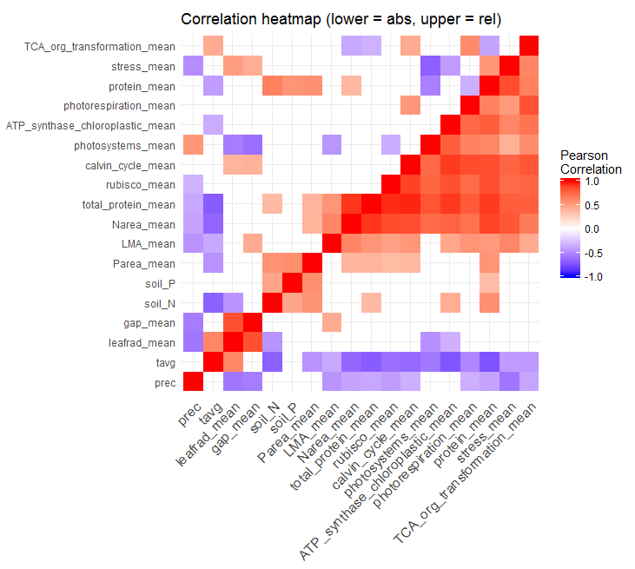
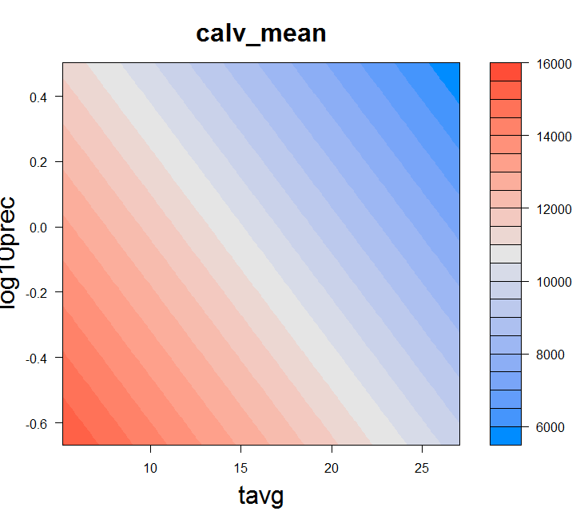
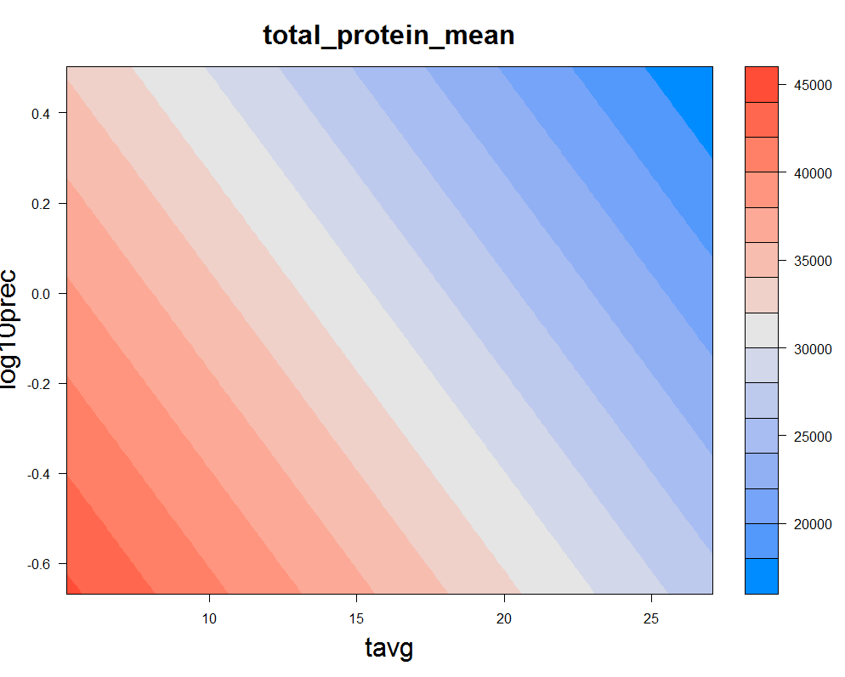
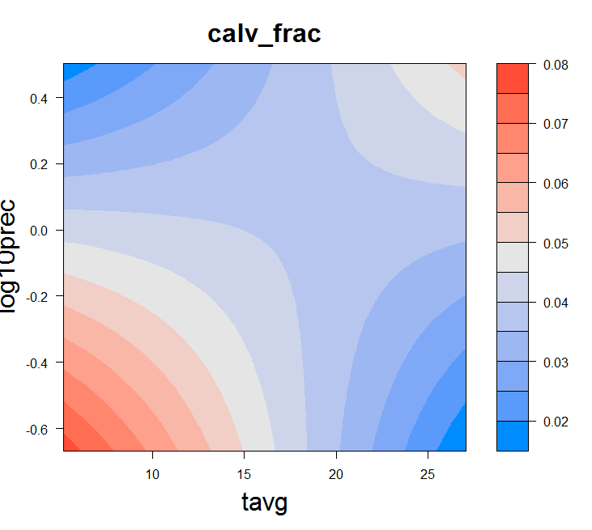
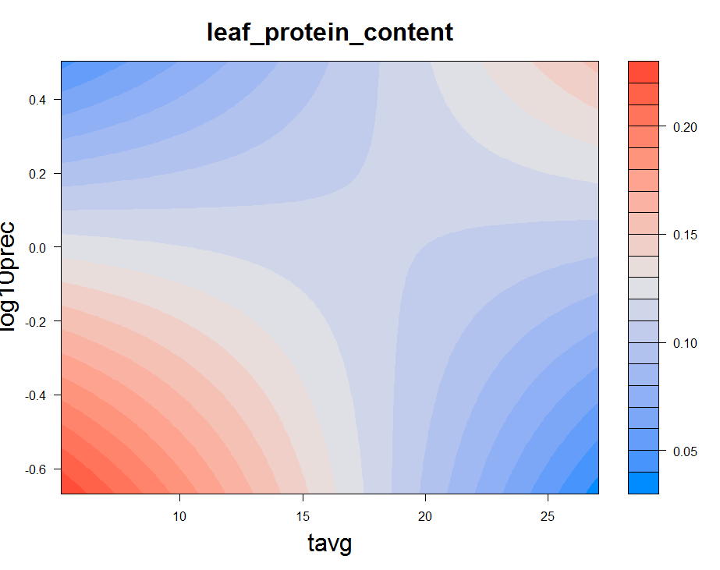
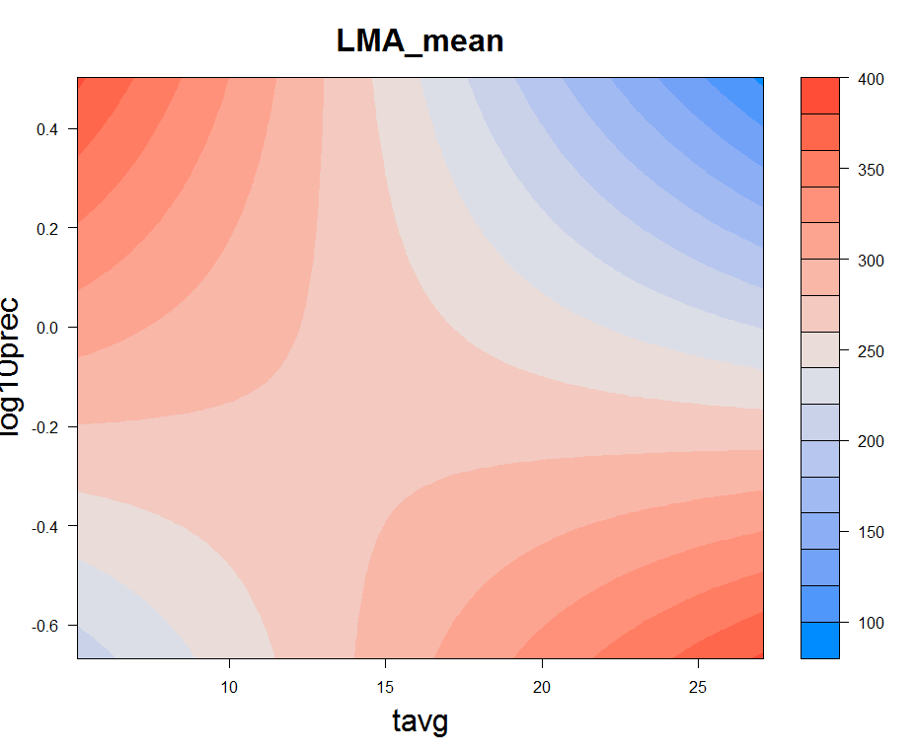
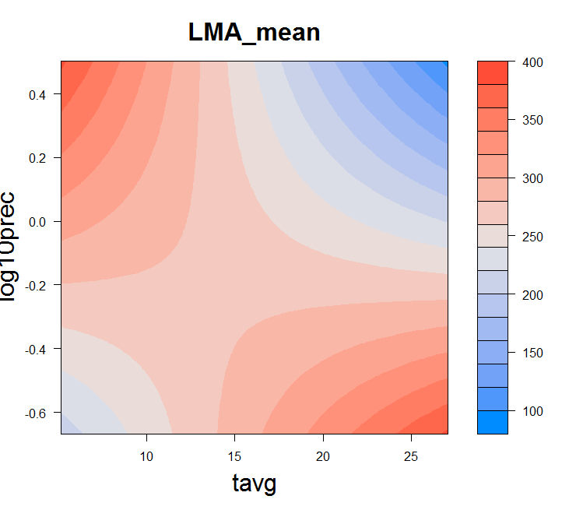
Total protein amounts are strongly driven by temp and to a lesser extent rainfall. Individual protein groups are all correlated positively with total protein to varying extent, implicating: 1.) a general thermodynamic requirement for greater amounts per leaf area of all major protein functional classes at lower temperatures, and 2.) a substitution of water use efficiency for N-use efficiency at low rainfall.s
Per leaf area trends in CC’s are essentially identical to environmental trends in leaf protein abundance (cor = 0.97). No strong effect of environment on proportional allocation of CC’s (although some response to irradiance). Some evidence that carboxylation capacity per leaf area is increased by increasing LMA, although there is substantial variation in the total protein – LMA relationship, indicating that LMA is responding to other requirements than photosynthetic capacity (see last para).
Patterns in per leaf area PS are also similar to patterns in total protein, although more variability is apparent in protein allocation to light harvesting capacity (cor = 0.82). Strong reduction in proportional allocation of protein to photosystems with increasing irradiance, and decreasing precip. Photosystem abundance does not increase on a per leaf area basis as leaves become thicker/denser, and reduces as a proportion of total leaf protein.
The role of LMA vs protein concentration (i.e. as a fraction of leaf dry mass) in determining per leaf area protein abundance depends interactively on MAP and MAT. Low per leaf area protein abundance at warm, wet sites is more closely associated with low LMA than low protein concentration, while high per leaf area protein abundance at cool, dry sites is strongly associated with high protein concentration. (This isn’t anything that couldn’t have been done using LMA, leaf N% and leaf N_area, but the point to make is that it’s not all just about increasing carboxylation capacity by adding layers of mesophyll).
a
c
i
iii
ii
iv
d
d
i
i
b
i
iii
v
ii
ii
ii
iv
vi
iii
iii
Notes:
3.) Linking leaf protein abundances with environment and functional traits.
a.) Correlations between environmental variables, leaf functional traits and major protein functional categories. Pairwise Pearson correlations between pairs of variables are represented by coloured tiles where p < 0.05. Protein abundances on a per leaf area basis (mg protein / m2 leaf area) are used to calculate correlations presented in the bottom/right diagonal and proportional protein abundances (i.e. fraction of total leaf protein abundance) are used to calculate correlations presented in the top/left diagonal.
b.) Trends in abundance of photosystem proteins [symbol, colour] and Calvin cycle enzymes [symbol, colour] are shown across gradients of: i,ii.) mean annual temperature (MAT, oC) R2 = , modelled change (%) = , p =.; iii,iv.) mean annual precipitation (MAP, mm/year) R2 = , modelled change (%) = , p = ; v,vi.) canopy-corrected mean annual irradiance (MJ/m2/year), R2 = , modelled change (%) = , p = . Points represent the average protein abundance for individual species * site combinations (n = 9, 3 leaves from each of 3 individuals). SEM (standard error of the mean) error bars are presented for protein abundances (y-axis) and for canopy-corrected irradiances (x-axis) (mean canopy openness values are derived from measurements of three individuals). Model fits (OLS regression) are shown where p < 0.05.
The top row of the lower panel (i, iii, v) shows models fit using protein abundances expressed on a per leaf area basis (mg protein / m2 leaf area); the bottom row (ii, iv, vi,) shows models fit using protein abundances expressed on a fractional basis (i.e. as a fraction of the total amount of protein in the leaf).
c.) Influence of leaf traits on photosynthetic protein abundance:
i.) Neither photosystems nor Calvin cycle enzymes change proportionally in response to total leaf protein, p = , R2 = ; ii.) on a per leaf area basis, abundances of both functional categories strongly track leaf total protein, although there is more variation associated with photosystem protein abundances than Calvin cycle protein abundances. iii.) Proportional abundance of photosystem proteins declines as leaf mass per area (LMA, g/m2) increases (R2 = , p = ), but no such trend is apparent for Calvin cycle proteins (p = , R2 = ); iv.) On a per leaf area basis, abundance of Calvin cycle proteins increases with LMA (R2 =, p = ), while photosystem protein abundance does not change (R2 = , p = ).
d.) Modelled contributions of leaf protein fraction versus LMA to CCarea across gradients of temperature and precipitation.
i.) Substantial variation in Ccarea is explained by linear combination of MAT and MAP (R2, p value). Leaves at cold, dry sites have the most carboxylation capacity per light-exposed surface, while those at warm wet sites have the least.
ii.) Calvin cycle protein concentration (the fraction of leaf dry mass comprised by Calvin cycle proteins) was explained by interaction, but not linear combination of MAT and MAP (R2, pval). High Calvin cycle protein concentration was congruent with Ccarea at cold dry sites, but no such similarity was apparent at warm wet sites.
iii.) LMA was also explained interactively by MAT and MAP (R2, pval). Low Ccarea at was congruent with low LMA at warm wet sites.
Multiple regression models are visualised using colouration to indicate the modelled magnitude of protein abundance in two-dimensional environmental space. Curved contours indicate significant interaction effects between predictors. A full table of multiple regression statistics associated with Xd is presented in the supplementary materials.

Slide 4
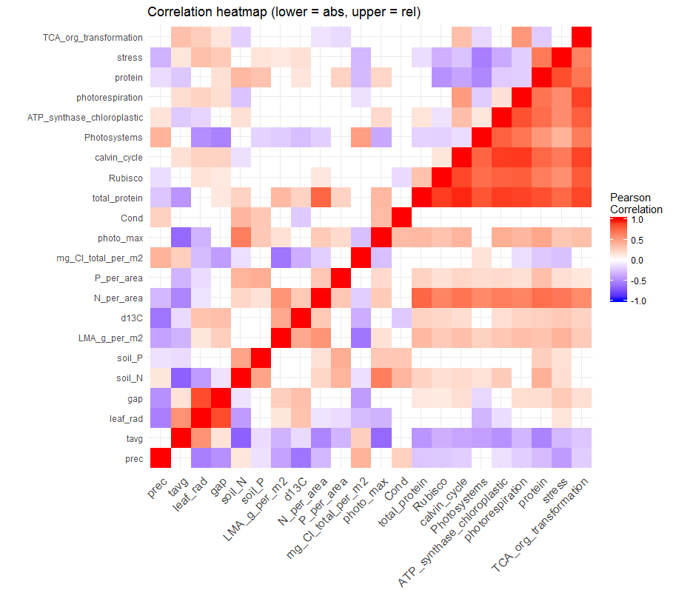
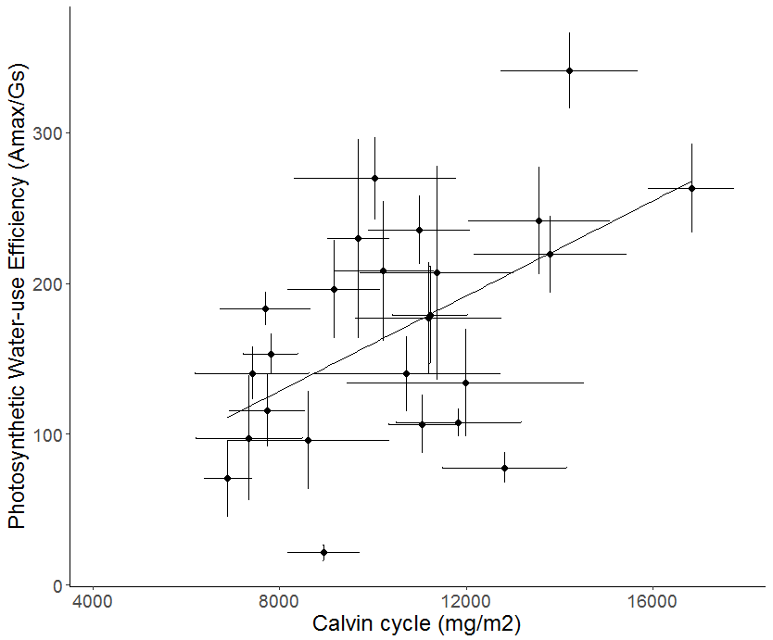
Total protein amounts are strongly driven by temp and to a lesser extent rainfall. Individual protein groups are all correlated positively with total protein to varying extent, implicating: 1.) a general thermodynamic requirement for greater amounts per leaf area of all major protein functional classes at lower temperatures, and 2.) a substitution of water use efficiency for N-use efficiency at low rainfall.s
Per leaf area trends in CC’s are essentially identical to environmental trends in leaf protein abundance (cor = 0.97). No strong effect of environment on proportional allocation of CC’s (although some response to irradiance). Some evidence that carboxylation capacity per leaf area is increased by increasing LMA, although there is substantial variation in the total protein – LMA relationship, indicating that LMA is responding to other requirements than photosynthetic capacity (see last para).
Patterns in per leaf area PS are also similar to patterns in total protein, although more variability is apparent in protein allocation to light harvesting capacity (cor = 0.82). Strong reduction in proportional allocation of protein to photosystems with increasing irradiance, and decreasing precip. Photosystem abundance does not increase on a per leaf area basis as leaves become thicker/denser, and reduces as a proportion of total leaf protein.
The role of LMA vs protein concentration (i.e. as a fraction of leaf dry mass) in determining per leaf area protein abundance depends interactively on MAP and MAT. Low per leaf area protein abundance at warm, wet sites is more closely associated with low LMA than low protein concentration, while high per leaf area protein abundance at cool, dry sites is strongly associated with high protein concentration. (This isn’t anything that couldn’t have been done using LMA, leaf N% and leaf N_area, but the point to make is that it’s not all just about increasing carboxylation capacity by adding layers of mesophyll).
a
c
i
iii
ii
iv
d
i
b
i
iii
v
ii
e
ii
iv
vi
iii
Notes:
3.) Linking leaf protein abundances with environment and functional traits.
a.) We are able to assess wide-area environmental patterns of leaf proteins with specific function, at any level of protein organisation. Here we show a heatmap of correlations between environmental variables, functional traits, gas exchange measurements and major protein functional categories. Pearson correlations between pairs of variables are represented by coloured tiles where p < 0.05. Protein abundances on a per leaf area basis (mg protein / m2 leaf area) are used to calculate correlations presented in the bottom/right diagonal and proportional protein abundances (i.e. fraction of total leaf protein abundance) are used to calculate correlations presented in the top/left diagonal.
b.) We selected several relationships for deeper analysis which are of current interest to the vegetation modelling community, but which to date have only been investigated via proxies. Trends in abundance of photosystem proteins [symbol, colour] and Calvin cycle enzymes [symbol, colour] are shown across gradients of: i,ii.) canopy-corrected mean annual irradiance (MJ/m2/year), R2 = , modelled change (%) = , p = ; iii,iv.) mean annual precipitation (MAP, mm/year) R2 = , modelled change (%) = , p = ; v,vi.) mean annual temperature (MAT, oC) R2 = , modelled change (%) = , p =.
Points represent the average protein abundance for individual species * site combinations (n = 9, 3 leaves from each of 3 individuals). SEM error bars are presented for protein abundances and for canopy-corrected irradiances, since mean canopy openness values are derived from measurements of three individuals. Model fits (OLS regression) are shown where p < 0.05. A full table of univariate OLS regression statistics associated with Fig Xb and Xc is provided in the supplementary materials.
The top row of the lower panel (i, iii, v) shows models fit using protein abundances expressed on a proportional basis; the bottom row (ii, iv, vi,) shows models fit using protein abundances expressed on a per leaf area basis (mg protein / m2 leaf area).
c.) Influence of leaf traits on photosynthetic protein abundance:
i.) Neither photosystems nor Calvin cycle enzymes change proportionally in response to total leaf protein, p = , R2 = ; ii.) on a per leaf area basis, abundances of both functional categories strongly track leaf total protein, although there is more variation associated with photosystem protein abundances than Calvin cycle protein abundances. iii.) Proportional abundance of photosystem proteins declines as leaf mass per area (LMA, g/m2) increases (R2 = , p = ), but no such trend is apparent for Calvin cycle proteins (p = , R2 = ); iv.) On a per leaf area basis, abundance of Calvin cycle proteins increases with LMA (R2 =, p = ), while photosystem protein abundance does not change (R2 = , p = ).
d.) Multiple regression models visualised using coloration to indicate the modelled magnitude of protein abundance in two-dimensional environmental space. Curved contours indicate significant interaction effects between predictors. A full table of multiple regression statistics is presented in the supplementary materials.
TO COMPLETE

Slide 5
Total protein amounts are strongly driven by temp and to a lesser extent rainfall. Individual protein groups are all correlated positively with total protein to varying extent, implicating: 1.) a general thermodynamic requirement for greater amounts per leaf area of all major protein functional classes at lower temperatures, and 2.) a substitution of water use efficiency for N-use efficiency at low rainfall.s
Per leaf area trends in CC’s are essentially identical to environmental trends in leaf protein abundance (cor = 0.97). No strong effect of environment on proportional allocation of CC’s (although some response to irradiance). Some evidence that carboxylation capacity per leaf area is increased by increasing LMA, although there is substantial variation in the total protein – LMA relationship, indicating that LMA is responding to other requirements than photosynthetic capacity (see last para).
Patterns in per leaf area PS are also similar to patterns in total protein, although more variability is apparent in protein allocation to light harvesting capacity (cor = 0.82). Strong reduction in proportional allocation of protein to photosystems with increasing irradiance, and decreasing precip. Photosystem abundance does not increase on a per leaf area basis as leaves become thicker/denser, and reduces as a proportion of total leaf protein.
The role of LMA vs protein concentration (i.e. as a fraction of leaf dry mass) in determining per leaf area protein abundance depends interactively on MAP and MAT. Low per leaf area protein abundance at warm, wet sites is more closely associated with low LMA than low protein concentration, while high per leaf area protein abundance at cool, dry sites is strongly associated with high protein concentration. (This isn’t anything that couldn’t have been done using LMA, leaf N% and leaf N_area, but the point to make is that it’s not all just about increasing carboxylation capacity by adding layers of mesophyll).
a
c
i
iii
ii
iv
b
d
i
iii
v
i
ii
iv
vi
Notes:
3.) Linking leaf protein abundances with environment and functional traits.
a.) We are able to assess wide-area environmental patterns of leaf proteins with specific function, at any level of protein organisation. Here we show a heatmap of correlations between environmental variables, functional traits, gas exchange measurements and major protein functional categories. Pearson correlations between pairs of variables are represented by coloured tiles where p < 0.05. Protein abundances on a per leaf area basis (mg protein / m2 leaf area) are used to calculate correlations presented in the bottom/right diagonal and proportional protein abundances (i.e. fraction of total leaf protein abundance) are used to calculate correlations presented in the top/left diagonal.
b.) We selected several relationships for deeper analysis which are of current interest to the vegetation modelling community, but which to date have only been investigated via proxies. Trends in abundance of photosystem proteins [symbol, colour] and Calvin cycle enzymes [symbol, colour] are shown across gradients of: i,ii.) canopy-corrected mean annual irradiance (MJ/m2/year), R2 = , modelled change (%) = , p = ; iii,iv.) mean annual precipitation (MAP, mm/year) R2 = , modelled change (%) = , p = ; v,vi.) mean annual temperature (MAT, oC) R2 = , modelled change (%) = , p =.
Points represent the average protein abundance for individual species * site combinations (n = 9, 3 leaves from each of 3 individuals). SEM error bars are presented for protein abundances and for canopy-corrected irradiances, since mean canopy openness values are derived from measurements of three individuals. Model fits (OLS regression) are shown where p < 0.05. A full table of univariate OLS regression statistics associated with Fig Xb and Xc is provided in the supplementary materials.
The top row of the lower panel (i, iii, v) shows models fit using protein abundances expressed on a proportional basis; the bottom row (ii, iv, vi,) shows models fit using protein abundances expressed on a per leaf area basis (mg protein / m2 leaf area).
c.) Influence of leaf traits on photosynthetic protein abundance:
i.) Neither photosystems nor Calvin cycle enzymes change proportionally in response to total leaf protein, p = , R2 = ; ii.) on a per leaf area basis, abundances of both functional categories strongly track leaf total protein, although there is more variation associated with photosystem protein abundances than Calvin cycle protein abundances. iii.) Proportional abundance of photosystem proteins declines as leaf mass per area (LMA, g/m2) increases (R2 = , p = ), but no such trend is apparent for Calvin cycle proteins (p = , R2 = ); iv.) On a per leaf area basis, abundance of Calvin cycle proteins increases with LMA (R2 =, p = ), while photosystem protein abundance does not change (R2 = , p = ).
d.) Multiple regression models visualised using coloration to indicate the modelled magnitude of protein abundance in two-dimensional environmental space. Curved contours indicate significant interaction effects between predictors. A full table of multiple regression statistics is presented in the supplementary materials.
i.) Proportional abundance of photosystem proteins modelled by MAT and incident irradiance (adjusted multiple R2 (adj.R2) = , p(interaction) = , etc.). The strong univariate relationship between photosystem proportional abundance (PS(prop)) and incident irradiance is modulated by MAT. At warm sites, PS(prop) follows our expectations and is highest at warm high irradiance sites, and lowest at warm low irradiance sites. No relationship between irradiance and PS(prop) is apparent at cool sites, however.
ii.) Per leaf area abundance of photosystems proteins (PS(area)) modelled by MAT and MAP (adjusted multiple R2 (adj.R2) = , p(interaction) = , etc.). MAP and MAT interactively explain variation in PS(area), and a univariate relationship between PS(area) and MAP is only apparent at cool sites. This effect may result from the strong influence of temperature on total leaf protein concentration.
iii.) Proportional abundance of Calvin cycle proteins (Calv(prop))modelled by MAT and incident irradiance (adjusted multiple R2 (adj.R2) = , p(interaction) = , etc.). Calv(prop) is related to MAT and MAP by a simple additive relationship, similar in nature to and likely not independent of MAP/MAT influence on total leaf protein (Fig 1e) .
iv.) Per leaf area abundance of Calvin cycle proteins (Calv(area)) modelled by MAT and MAP (adjusted multiple R2 (adj.R2) = , p(interaction) = , etc.). Calv(area) is interactively related to incident irradiance and MAT: high temperature, high irradiance sites are associated with the highest Calv(area), while at low temperatures, higher irradiance predicts lower Calv(area). Care should be taken in interpretation here, however, as there were few low temperature sites with high incident irradiance to inform the model.

